Slide 1


The Future of Finance Roles in a Changing Talent Landscape:
A Fireside Chat With Fred Swaniker and Scott Powell
Privileged and Confidential. All Rights Reserved.

Slide 2
Agenda
Introduction
The Changing Economic and Talent Landscape
The Elevated Role of a Financial Analyst
New Paths Available to Employers in the New Landscape
Q&A

Slide 3

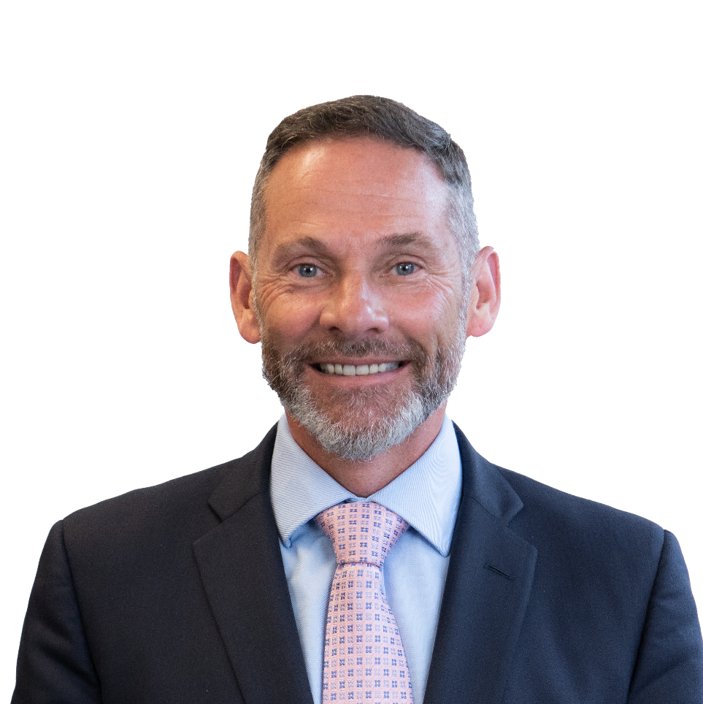
Fred Swaniker, Founder and CEO, ALX and The ROOM
Fred Swaniker is on a mission to bring better leadership to Africa and the world. He leads the African Leadership Group - an ecosystem of organisations that aims to catalyse a new era of ethical, entrepreneurial leaders for Africa. Over the past 15 years, he has founded and led the African Leadership Academy, African Leadership University, African Leadership Network, ALX and The ROOM. Collectively, these endeavours aim to transform Africa by developing 3 million African leaders by 2035. In 2019, he was named as one of the Time 100 Most Influential People in the World.
Scott Powell, Chief Content Officer, CFI
Scott is Co-Founder and Chief Creative Officer of CFI Education. Now based in Vancouver, Scott spent a significant portion of his career in London, New York and Hong Kong. Scott has a passion for teaching with over 25 years of experience designing and delivering customized learning solutions for firms in the financial services industry including JP Morgan, Deutsche Bank, Bank of America Merrill Lynch, Credit Suisse, and HSBC, to name but a few.

Slide 4

The ROOM is home to a lifelong, highly specialized community of skilled and early-stage talent that will power the future. Supported by its talent development training arm, ALX, The ROOM connects businesses of all sizes with its pool of top talent from across the African continent and the globe. Together, ALX and The ROOM seek to create a new generation of agile digital talent who can help companies thrive in the new world of work. As part of the African Leadership Group (ALG), ALX and The ROOM are connected to an innovative ecosystem with a collective mission of transforming the future of Africa by creating 2 million job opportunities by 2030 for young African talent, and inspiring the next generation of leaders.
Corporate Finance Institute (CFI) is the leading, accredited provider of online learning for finance and banking professionals. With comprehensive programs, certifications, and hundreds of courses ranging from financial modeling and capital markets to commercial banking and business intelligence, CFI equips learners with the most in-demand skills and competencies. Trusted by millions of learners and hundreds of teams everywhere, CFI delivers practical learning that makes a difference.

Slide 5

The Changing Economic and Talent Landscape
Notes:
What are the major forces affecting the economic/talent landscape at the moment?
How is the rapid pace of technology evolution affecting the talent landscape and future of work?
What are some of the immediate changes we’re seeing for employers and talent alike?
What long-term global impact can we anticipate (and how is the global landscape shifting geographically?)

Slide 6

The Elevated Role of a Financial Analyst
Notes:
How has digital transformation across the finance industry reshaped the roles of Finance Professionals?
How, and in which ways, does the role of Financial Analyst differ now from 5 or 10 years ago?
How can current and prospective Financial Analysts prepare for and take advantage of these changes?

Slide 7

New Paths Available to Employers in the New Landscape
Notes:
What opportunities are available to employers within this shifting talent landscape?
What are the top 3 most important things L&D and hiring managers should know to stay competitive in attracting new talent?
In an age of job-hopping and rapid turnover, what is key to retaining top talent?

Slide 8

Q&A

Slide 9
Visit theroom.com to learn more about the future of talent.

Slide 10
ZOOM BACKGROUND

