Slide 1

ASSOCIATION FOR TALENT DEVELOPMENT
Top 5 Trends Disrupting the Future of Learning
^{THE 5 BIG TRENDS}
^{5 MOST COMMON COMPLAINTS}
^{KEY QUESTIONS}

Slide 2
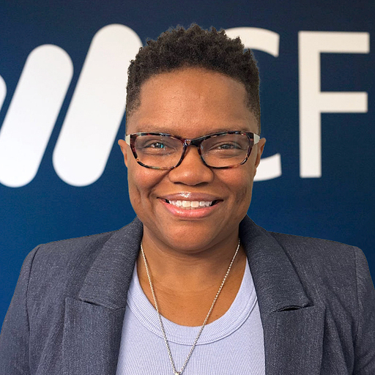
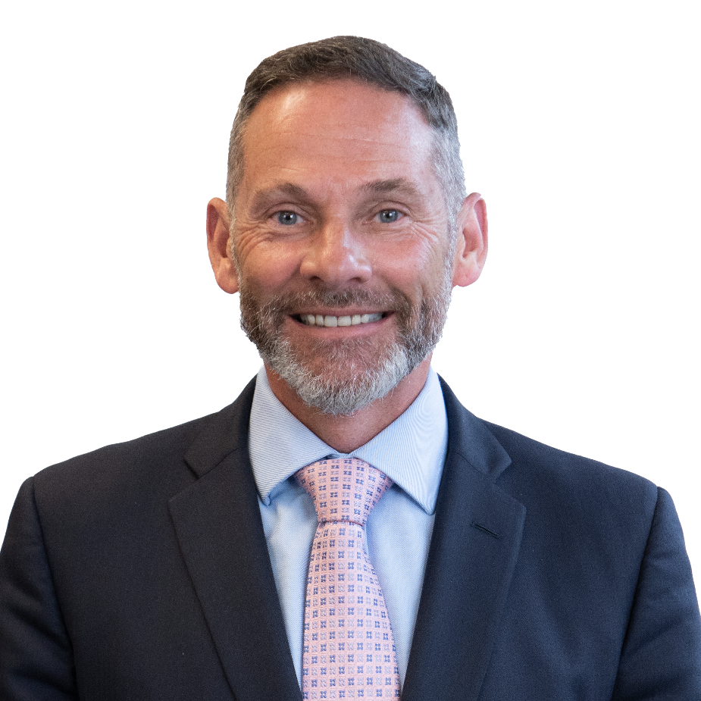

Facilitators
^{Tia Williams}
^{SVP, Content Operations}
^{Corporate Finance Institute}
Top 5 Trends Disrupting the Future of Learning
^{Scott Powell}
^{Chief Content Officer}
^{Corporate Finance Institute}

Slide 3


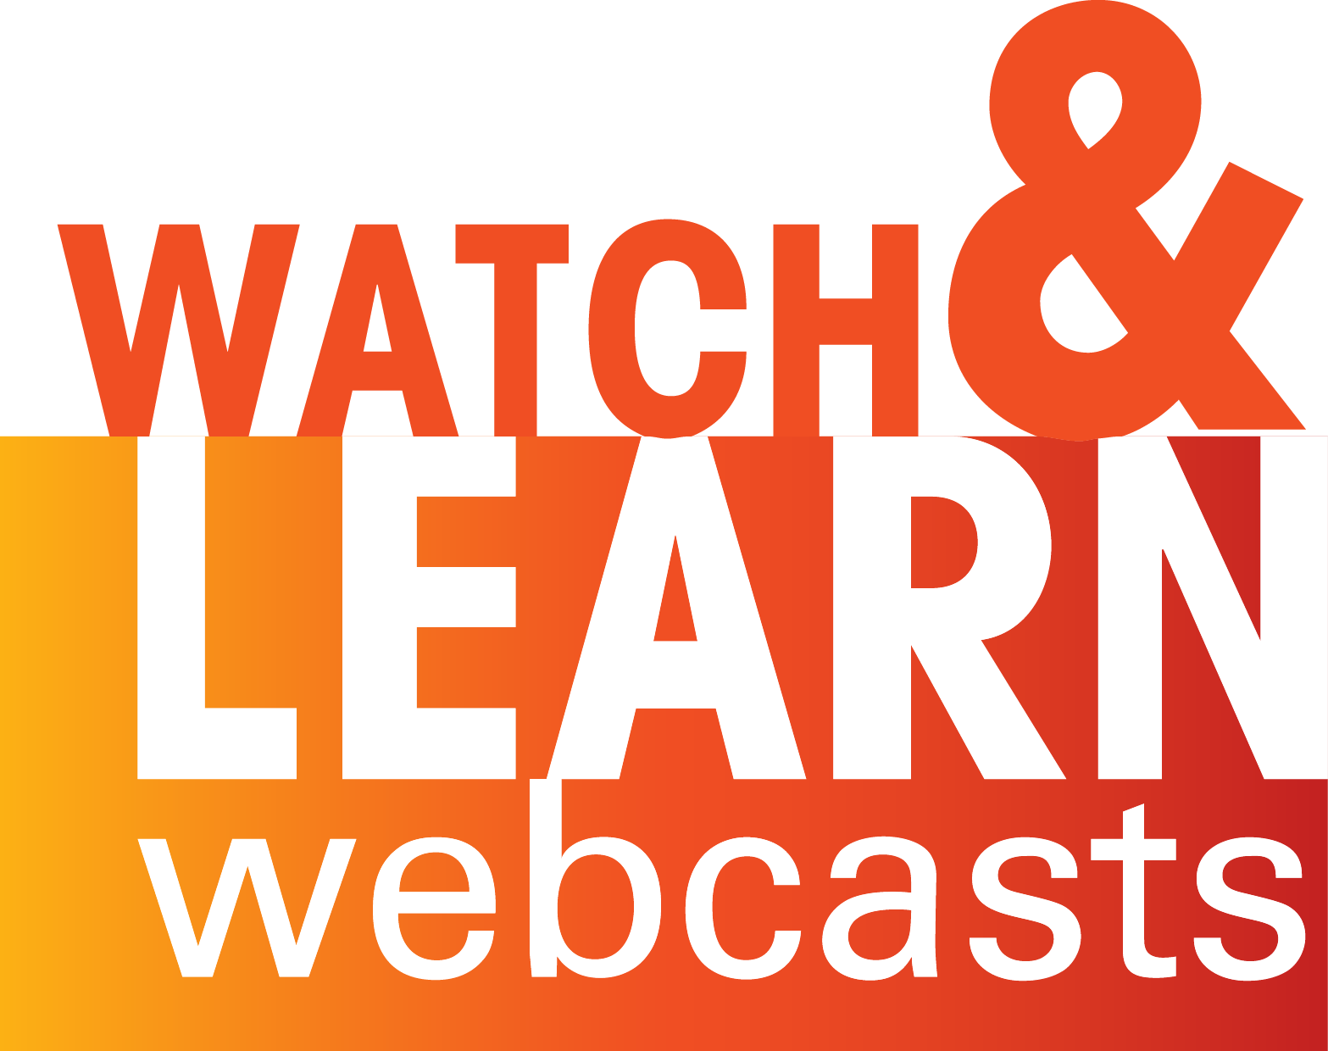
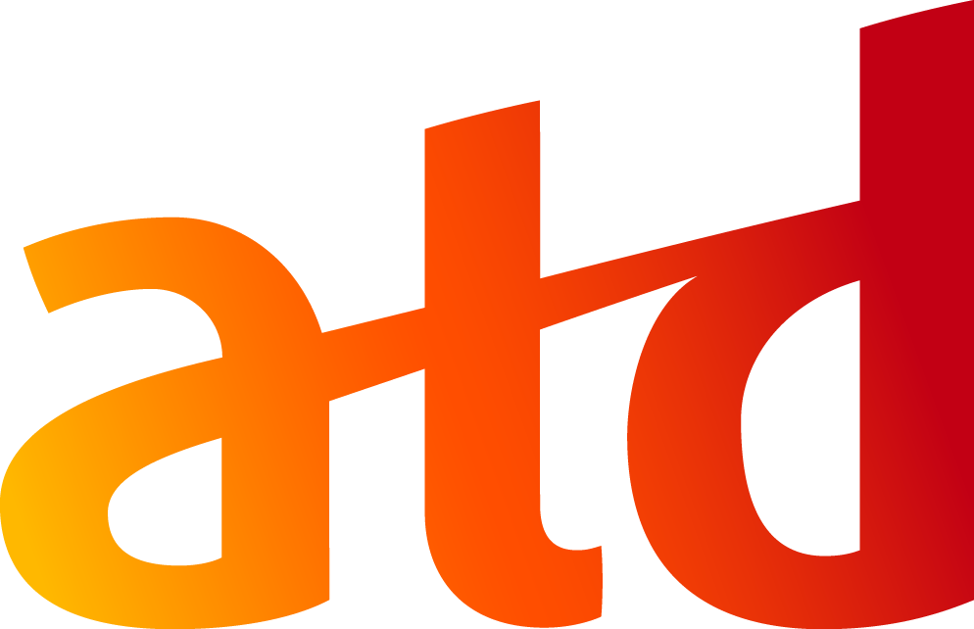
^{THE 5 BIG TRENDS}
^{5 MOST COMMON COMPLAINTS}
^{KEY QUESTIONS}
5 MOST COMMON COMPLAINTS
DISRUPTING THE FUTURE OF LEARNING

Slide 4


5 MOST COMMON COMPLAINTS
NOT RELEVANT
DOESN’T RELATE
Training is… not relevant to specific individuals.
TAKES THEM AWAY
POOR QUALITY
WRONG TIME
Notes:
Gone are the days where you put everyone in the same classroom, and everyone was trained on the same topics at the same time.
This “one size fits all” approach is increasingly out of date and doesn’t deliver the learning outcomes the firm is looking for.
Personalized learning paths tailored at the individual level are increasingly the way forward.
Learner’s undertake skills assessments to identify their skills gaps and then are given tailored learning paths that focus solely on their skills gaps.
Solution - bespoke individually personalized learning
Learner’s only get training that is relevant to their skill gaps.
Each learner can have a custom curated learning journey tailored to their needs.

Slide 5
^{PERSONALIZED}
^{EXPERIENTIAL}
^{PRECISION}
^{ENGAGING}
^{MICRO LEARNING}
THE 5 BIG TRENDS
DISRUPTING THE FUTURE OF LEARNING

Slide 6

^{PERSONALIZED}
^{EXPERIENTIAL}
^{PRECISION}
^{ENGAGING}
^{MICRO LEARNING}
Bespoke individually personalized learning.

Slide 7
5 MOST COMMON COMPLAINTS
NOT RELEVANT
DOESN’T RELATE
Training… doesn’t relate to what the individual needs to do on the desk.
TAKES THEM AWAY
POOR QUALITY
WRONG TIME
Notes:
Learners are no longer willing to tolerate learning where there isn’t a clear and compelling “what’s in it for me (WIFM)”.
Learner needs to be all about skills and job-related tasks and what the learner actually needs to do in the workplace.
Learning needs to focus on application and learning by doing rather than just hearing or watching.
Solution - experiential, practical task-based learning
Experiential learning is structured to model actual work placed tasks.
Applied case studies and simulations mimic the real-world environment.
Learners can practice in a safe environment.

Slide 8

^{PERSONALIZED}
^{EXPERIENTIAL}
^{PRECISION}
^{ENGAGING}
^{MICRO LEARNING}
Experiential, practical
task-based learning.

Slide 9
5 MOST COMMON COMPLAINTS
NOT RELEVANT
DOESN’T RELATE
Training…
takes them away from their work for too long.
TAKES THEM AWAY
POOR QUALITY
WRONG TIME
Notes:
Learners are no longer willing to tolerate learning where there isn’t a clear and compelling “what’s in it for me (WIFM)”.
Learner needs to be all about skills and job-related tasks and what the learner actually needs to do in the workplace.
Learning needs to focus on application and learning by doing rather than just hearing or watching.
Solution - experiential, practical task-based learning
Experiential learning is structured to model actual work placed tasks.
Applied case studies and simulations mimic the real-world environment.
Learners can practice in a safe environment.

Slide 10

^{PERSONALIZED}
^{EXPERIENTIAL}
^{PRECISION}
^{ENGAGING}
^{MICRO LEARNING}
Precision learning.

Slide 11
5 MOST COMMON COMPLAINTS
NOT RELEVANT
DOESN’T RELATE
Training…
boring / poor quality.
TAKES THEM AWAY
POOR QUALITY
WRONG TIME
Notes:
Learners are increasingly intolerant of poor quality/ boring learning solutions that simply tick the box.
Learners want learning that is high engaging, encouraging them to stay focused and get the most of their learning solution.
Solution - highly engaging learning
Learners will be more focused/ less distracted.
Learners will more quickly build new skills, close skills gaps.

Slide 12

^{PERSONALIZED}
^{EXPERIENTIAL}
^{PRECISION}
^{ENGAGING}
^{MICRO LEARNING}
Highly engaging learning.

Slide 13
5 MOST COMMON COMPLAINTS
NOT RELEVANT
DOESN’T RELATE
Training…
happens at the wrong time.
TAKES THEM AWAY
POOR QUALITY
(When the person is too busy, they could have used it much earlier, etc.)
WRONG TIME
Notes:
Learners don’t want to learn things they can’t put into practice immediately.
Learners often need to learn in the flow of work when tasked with something new in a just-in-time fashion.
Learners are left to figure things out on their own thoroughly googling or YouTube.
Solution - micro learning in the flow of work
Learners learn exactly when they need to in order to complete a workbased task
Learners get to apply their learning immediately.

Slide 14

^{PERSONALIZED}
^{EXPERIENTIAL}
^{PRECISION}
^{ENGAGING}
^{MICRO LEARNING}
Micro learning in the flow of work.

Slide 15
^{THE 5 BIG TRENDS}
^{5 MOST COMMON COMPLAINTS}
^{KEY QUESTIONS}
THE 5 BIG TRENDS
DISRUPTING THE FUTURE OF LEARNING
Bespoke individually personalized learning.
Experiential, practical task-based learning.
Precision learning.
Highly engaging learning.
Micro learning in the flow of work.

Slide 16
^{THE 5 BIG TRENDS}
^{5 MOST COMMON COMPLAINTS}
^{KEY QUESTIONS}
KEY QUESTIONS TO CONSIDER
/ What can you do to bring in learning solutions that are…

Slide 17
^{THE 5 BIG TRENDS}
^{5 MOST COMMON COMPLAINTS}
^{5 KEY QUESTIONS}
Capable of creating personalized learning paths.
Notes:
KEY QUESTIONS TO CONSIDER
/ What can you do to bring in learning solutions that are…

Slide 18
^{THE 5 BIG TRENDS}
^{5 MOST COMMON COMPLAINTS}
^{5 KEY QUESTIONS}
Capable of creating personalized learning paths.
Experiential and allow learners to practice work placed tasks.

Slide 19
^{THE 5 BIG TRENDS}
^{5 MOST COMMON COMPLAINTS}
^{5 KEY QUESTIONS}
Capable of creating personalized learning paths.
Experiential and allow learners to practice work placed tasks.
Focused on precise learning objectives rather than numerous objectives all at one.

Slide 20
^{THE 5 BIG TRENDS}
^{5 MOST COMMON COMPLAINTS}
^{5 KEY QUESTIONS}
Capable of creating personalized learning paths.
Experiential and allow learners to practice work placed tasks.
Focused on precise learning objectives rather than numerous objectives all at one.
Highly engaging for learners.

Slide 21
^{THE 5 BIG TRENDS}
^{5 MOST COMMON COMPLAINTS}
^{5 KEY QUESTIONS}
Capable of creating personalized learning paths.
Experiential and allow learners to practice work placed tasks.
Focused on precise learning objectives rather than numerous objectives all at one.
Highly engaging for learners.
Structured to allow learning in the flow of work rather than outside work.

