Slide 1


Accelerate Your Career in Finance

Slide 2

Agenda
Introduction
The Current State Of Corporate Finance
Five Key Drivers of Career Progression
Q&A

Slide 3
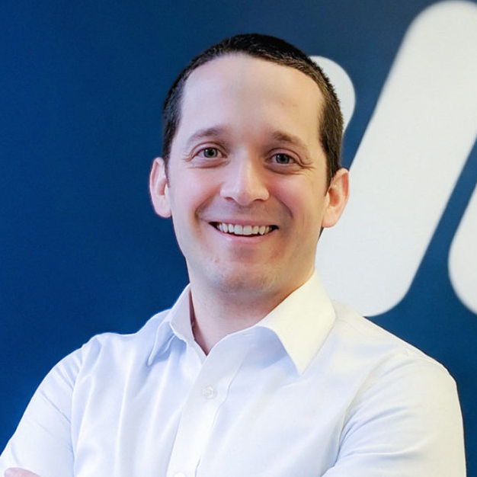
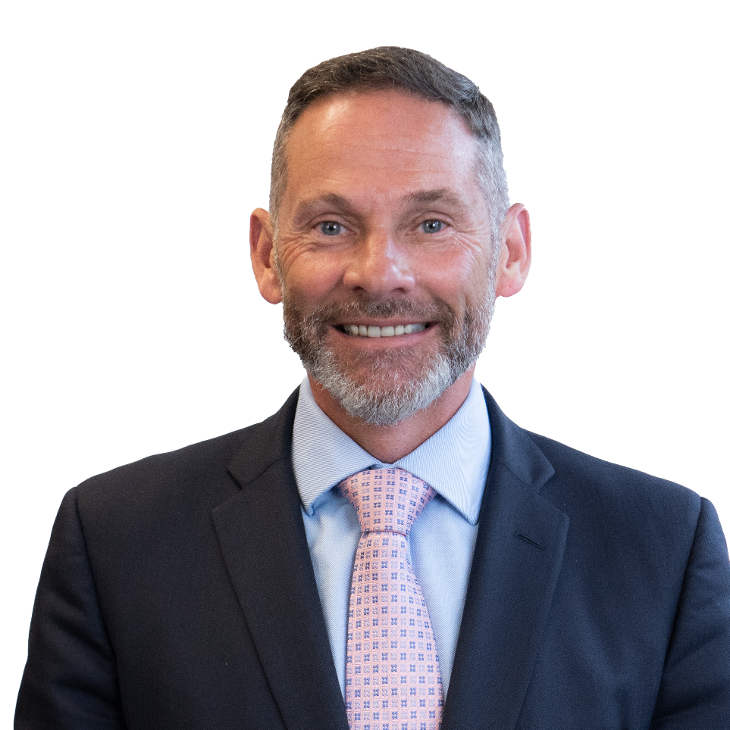
Introduction
Adam works with the Learning Design team at CFI to help their finance experts create world-class learning experiences. After 8 years of classroom teaching, he shifted to creating online experiences. Over the last decade, he has built and curated over 200 courses covering topic areas such as finance, business leadership, data analysis, marketing, UX design, and more. Adam thrives on community feedback and has a passion for data-driven design.
Adam Zollo
Team Lead - Senior Learning Designer
Scott is Co-Founder and Chief Content Officer of CFI Education. Now based in Vancouver, Scott spent a significant portion of his career in London, New York and Hong Kong. Scott has a passion for teaching with over 25 years of experience designing and delivering customized learning solutions for firms in the financial services industry including JP Morgan, Deutsche Bank, Bank of America, Merrill Lynch, Credit Suisse, and HSBC, to name but a few.
Scott Powell
Co-Founder and Chief Content Officer

Slide 4
CFI Values
Ambitious
We’re passionate about creating a world-class learning experience and productivity tools. Driven to provide a global go-to resource for current and aspiring finance professionals, we’ll accept nothing short of excellence for CFI and Macabacus customers.
Creative
We strive for innovation and welcome diverse perspectives to offer the best possible customer experience. Creative approaches and reframing are encouraged to give finance professionals the best real-world solutions to real-world problems.
Accountable
We set the highest standard of excellence as our benchmark, own our mistakes, and treat them as learning opportunities. Our content and products are relied on by customers to be relevant, applicable, valuable, and up-to-date—expectations we aim to exceed.
Data-Driven
We make decisions based on data and actionable insights, approaching everything with an informed and user-centric mindset. Consistent experimentation is encouraged to definitively understand what delivers the most value to our customers.
Inclusive
We foster a collaborative environment fueled by open-mindedness and feedback. As an international brand with over one million learners and professional customers, we’re mindful of creating a unified, accessible learning experience everyone can benefit from.
Agile
We’re designed to be adaptable, innovative, and resilient in the face of change. Being flexible in our solutions while maintaining core product integrity allows us to quickly and proactively respond to customer needs—without sacrificing quality.

Slide 5
POLL
Which CFI value resonates with you the most?

Slide 6
The Current State Of Corporate Finance
What does this mean for current and aspiring professionals?

Slide 7
Five Key Drivers of Career Progression
A strong foundation of knowledge and skills
Aim for T-shaped skills
Develop business acumen
Understand the industry trends
Strong communication and leadership skills
Get noticed and grow into senior leadership
Network and building relationships
Soft skills to advance your career
Continuous learning and professional development
Learn new skills, concepts, technology, and tools to get ahead

Slide 8
POLL
Which of these career drivers do you want to focus on?

Slide 9
What are the various career paths available in finance at a high level?

Slide 10
What are some entry level skills that can help a person to land their first job in the finance sector?

Slide 11
I don’t have any previous experience in finance, how do I get in?

Slide 12
In what ways are the CFI certifications and CFA designation compare or differ?

Slide 13
I have 7 years of experience in FP&A. I want to become a CFO one day. What are the most important skills to focus on?

Slide 14
Which CFI certification is perceived as most valuable for career advancement in the finance and banking?

Slide 15


Coming Soon
Thank you for attending!
/corporate-finance-institute-cfi
@corporatefinanceinstitute
@cfi_edu
/Corporatefinanceinstitute-CFI

