Slide 1
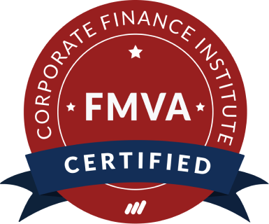
Drive Your Success with CFI:
Financial Modeling and Valuation

Slide 2

Agenda
Introduction
Why CFI?
FMVA Overview
Modeling Guidelines
Learning Tips
What’s Next?

Slide 3

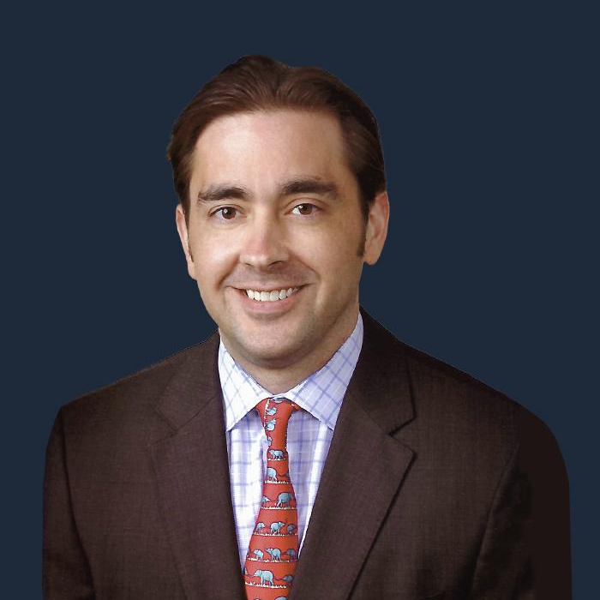
Introduction
Duncan is an effective communicator with extensive experience teaching financial modeling, accounting, analysis & valuation. Since 2014, Duncan has been focused on designing courses and teaching financial modeling to employees working in accounting, valuation, investment banking, equity research and private equity. He also has extensive experience providing consulting services on financial modeling to large corporations and institutions.
Duncan McKeen
EVP, Financial Modeling
Prior to joining CFI, for over a decade Jeff Schmidt taught financial modeling and valuation to thousands of students all over the world. Clients included some of the world’s largest corporations and financial institutions, as well as many of the most prestigious universities in the world. He also advised clients on modeling best practices, model rebuilds and streamlining large spreadsheets.
Jeff Schmidt
VP, Financial Modeling

Slide 4


Why CFI?

Slide 5
CFI Values
Ambitious
We’re passionate about creating a world-class learning experience and productivity tools. Driven to provide a global go-to resource for current and aspiring finance professionals, we’ll accept nothing short of excellence for CFI and Macabacus customers.
Creative
We strive for innovation and welcome diverse perspectives to offer the best possible customer experience. Creative approaches and reframing are encouraged to give finance professionals the best real-world solutions to real-world problems.
Accountable
We set the highest standard of excellence as our benchmark, own our mistakes, and treat them as learning opportunities. Our content and products are relied on by customers to be relevant, applicable, valuable, and up-to-date—expectations we aim to exceed.
Data-Driven
We make decisions based on data and actionable insights, approaching everything with an informed and user-centric mindset. Consistent experimentation is encouraged to definitively understand what delivers the most value to our customers.
Inclusive
We foster a collaborative environment fueled by open-mindedness and feedback. As an international brand with over one million learners and professional customers, we’re mindful of creating a unified, accessible learning experience everyone can benefit from.
Agile
We’re designed to be adaptable, innovative, and resilient in the face of change. Being flexible in our solutions while maintaining core product integrity allows us to quickly and proactively respond to customer needs—without sacrificing quality.

Slide 6
Poll: Which of our values resonates the most with you?

Slide 7
Overview of the FMVA

Slide 8
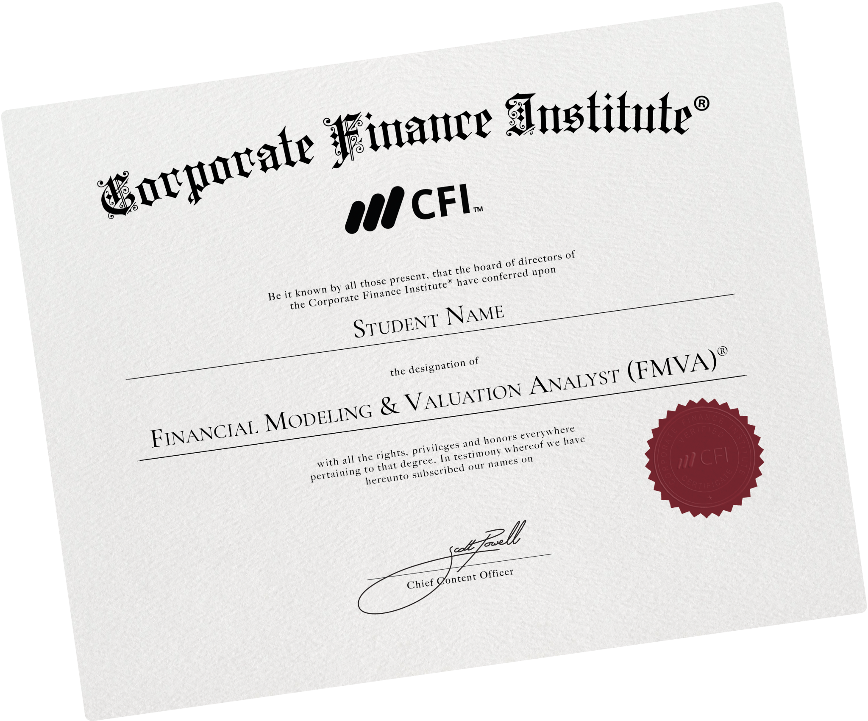
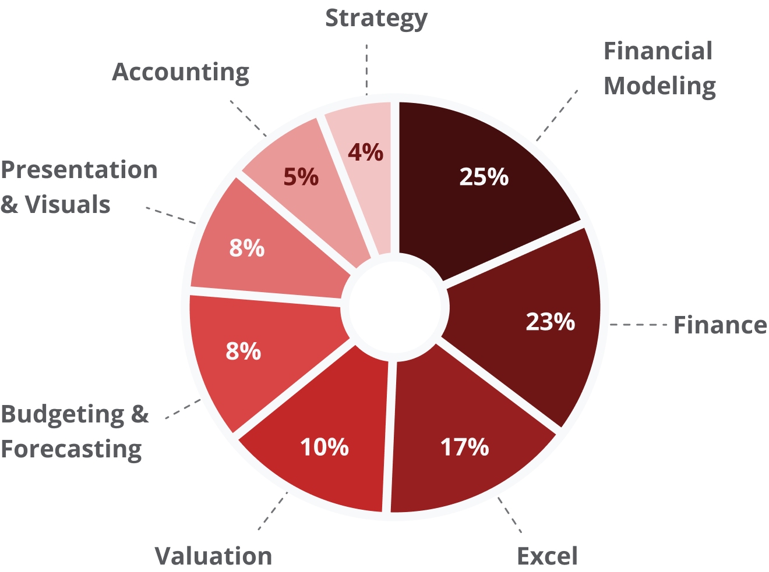
Why the FMVA?
37
190+
500,000+
courses
interactive exercises
5-star ratings

Slide 9
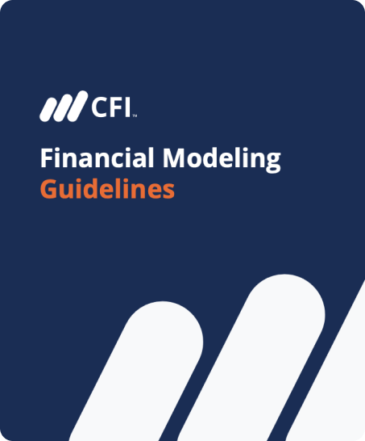
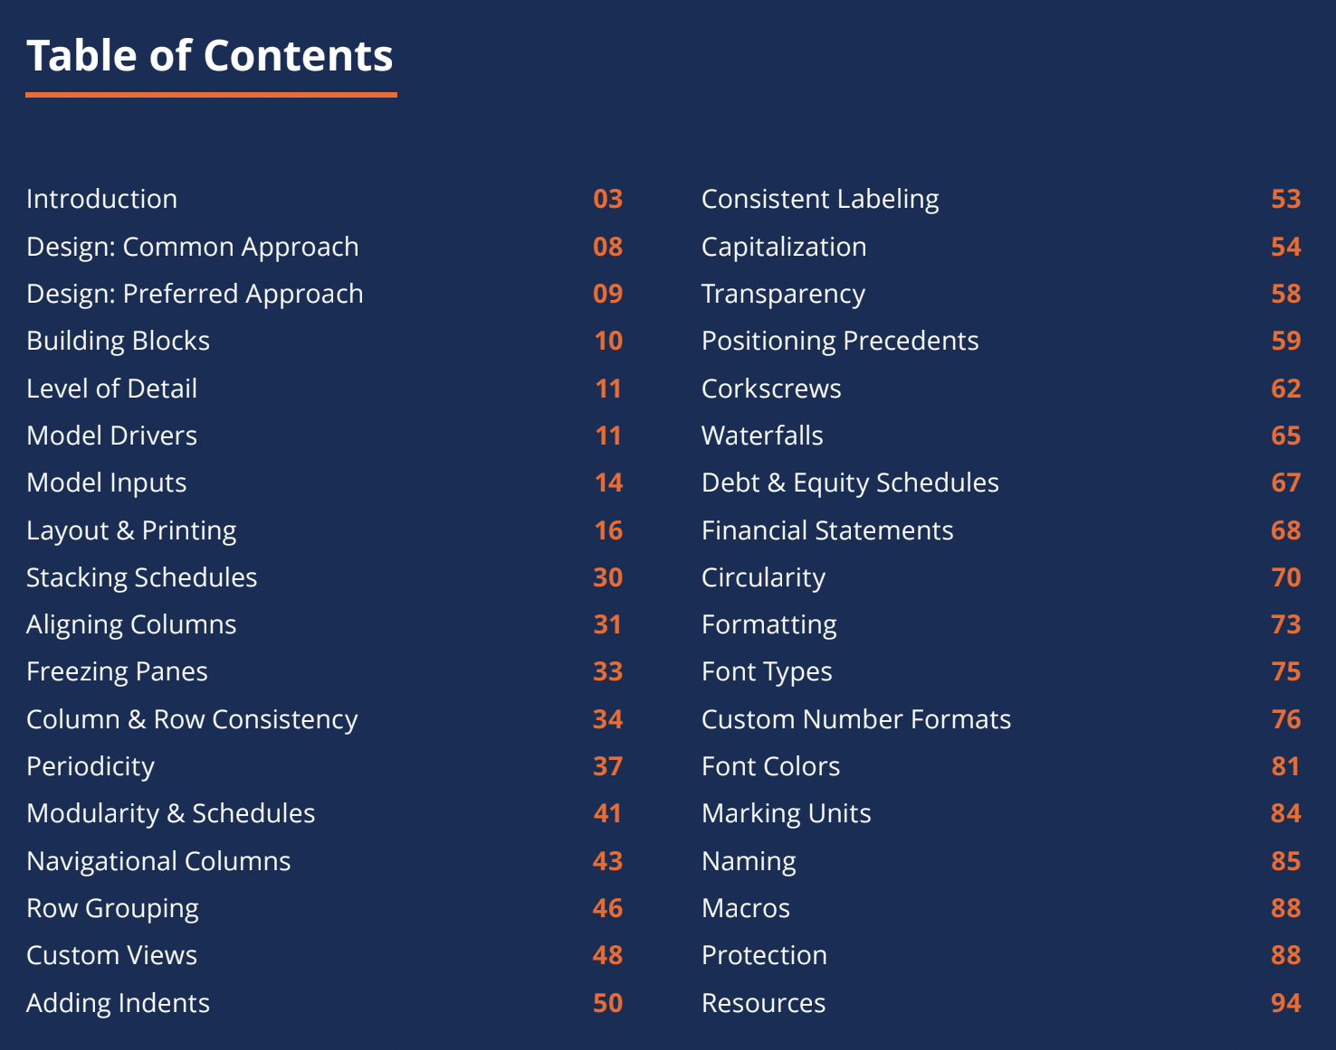
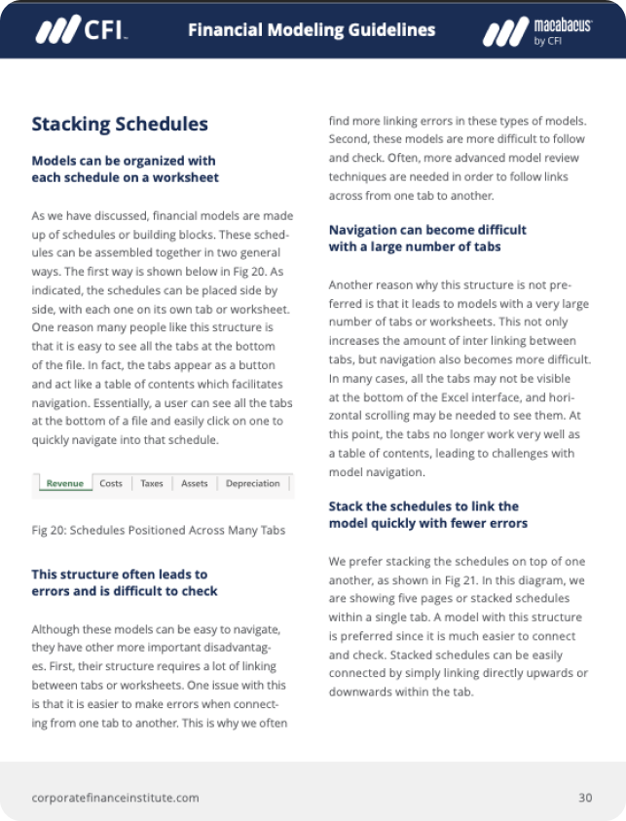
Financial Modeling Guidelines

Slide 10
Poll: Do you use a PC or a Mac computer?

Slide 11
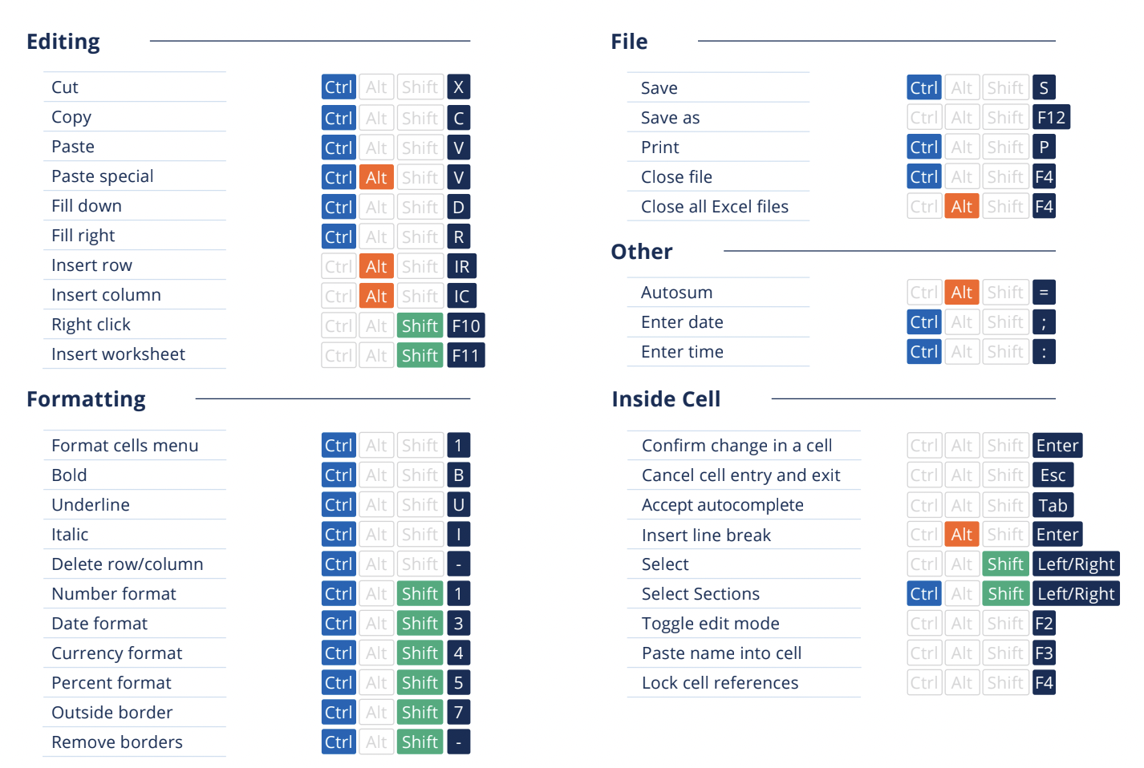
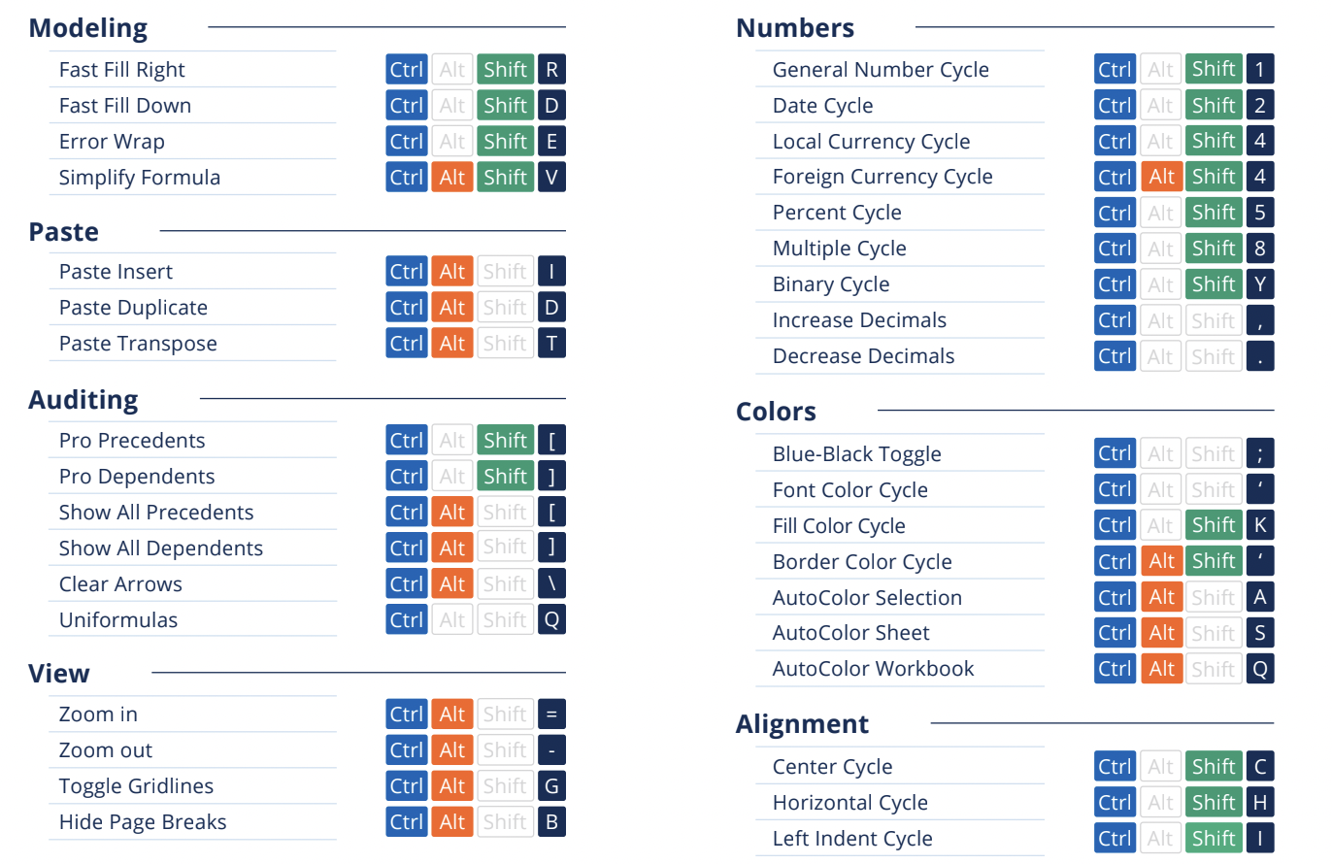
Learning Tip: Keyboard Shortcuts
Excel Shortcuts
Macabacus Shortcuts
Notes:
Keyboard shortcut cheatsheet - Excel is page 1, Macabacus is page 2

Slide 12
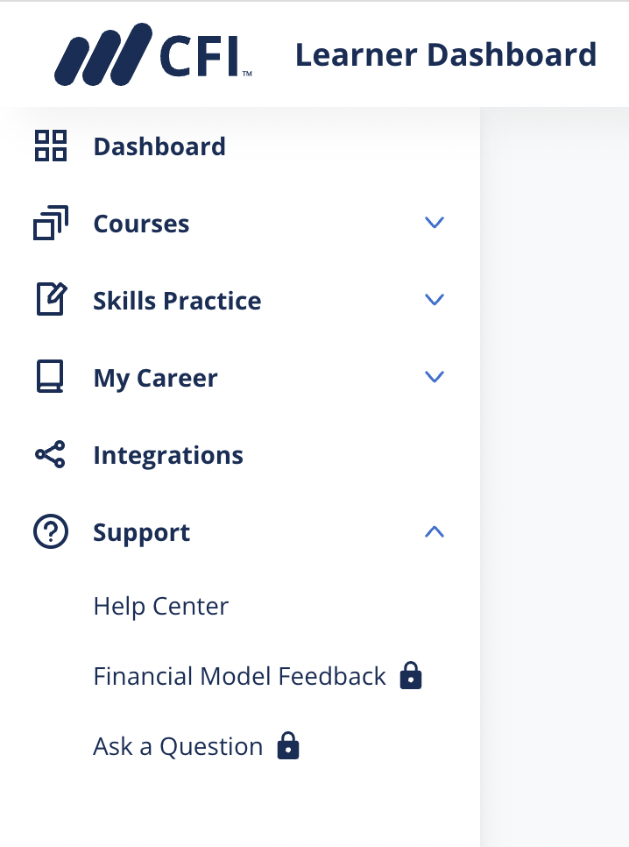
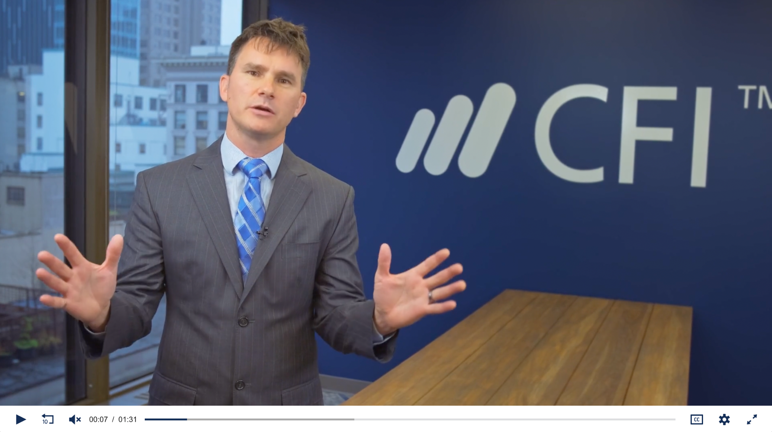
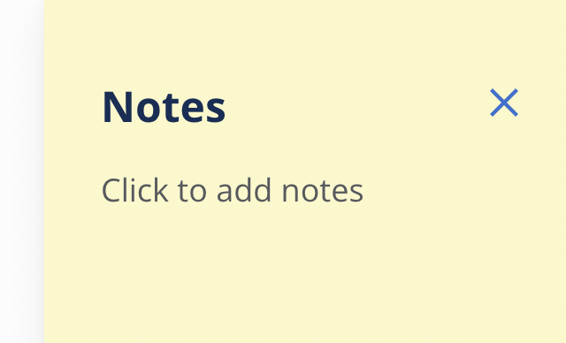
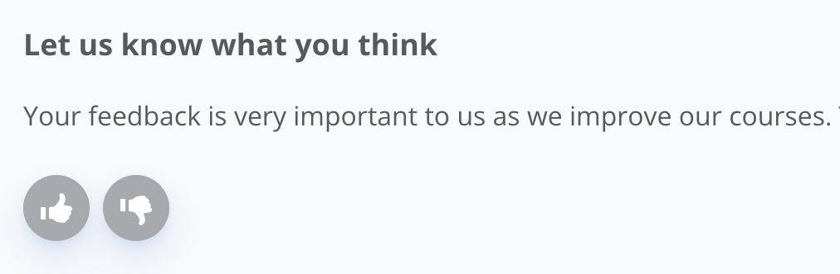
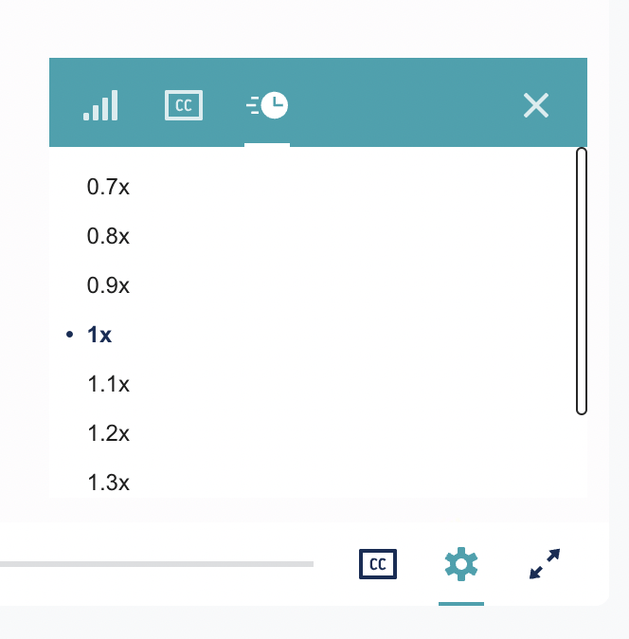
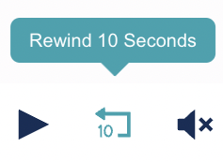

Learning Tip: Learning Management System (LMS)
Notes:
Highlight the following
Notes
Thumbs up/down
Where to reach out to customer support
Speed up and rewind

Slide 13
Poll: Which one of our LMS features do you like the best?

Slide 14

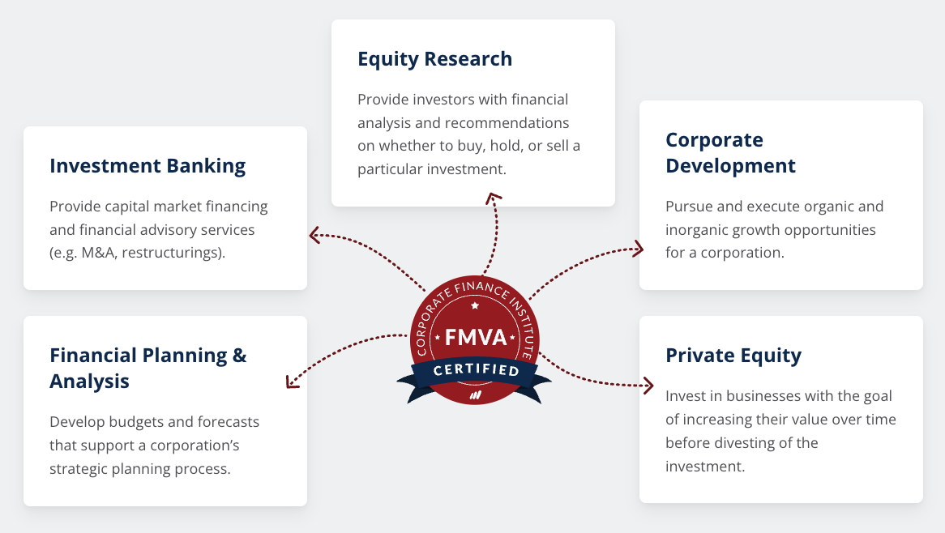
Career Paths and Opportunities
At first I was skeptical. Then I was intrigued. After 200 hours I was amazed.
This course has taught me to create, visualize and present clear, flexible and structured financial models. It teaches you critical hard skills that are necessary to efficiently build financial models from scratch.
Kobe W, Business Consultant
I have been looking for a way to get into Finance but hadn't been able to identify a credential that would do the job without interrupting my work schedule.
Thank you CFI, I look forward to learning more from your team!
Stephen M, Director of Operations
Notes:
Career paths found on this page

Slide 15
Poll: What do you hope to pursue with your FMVA?

Slide 16
What’s Next?

Slide 17
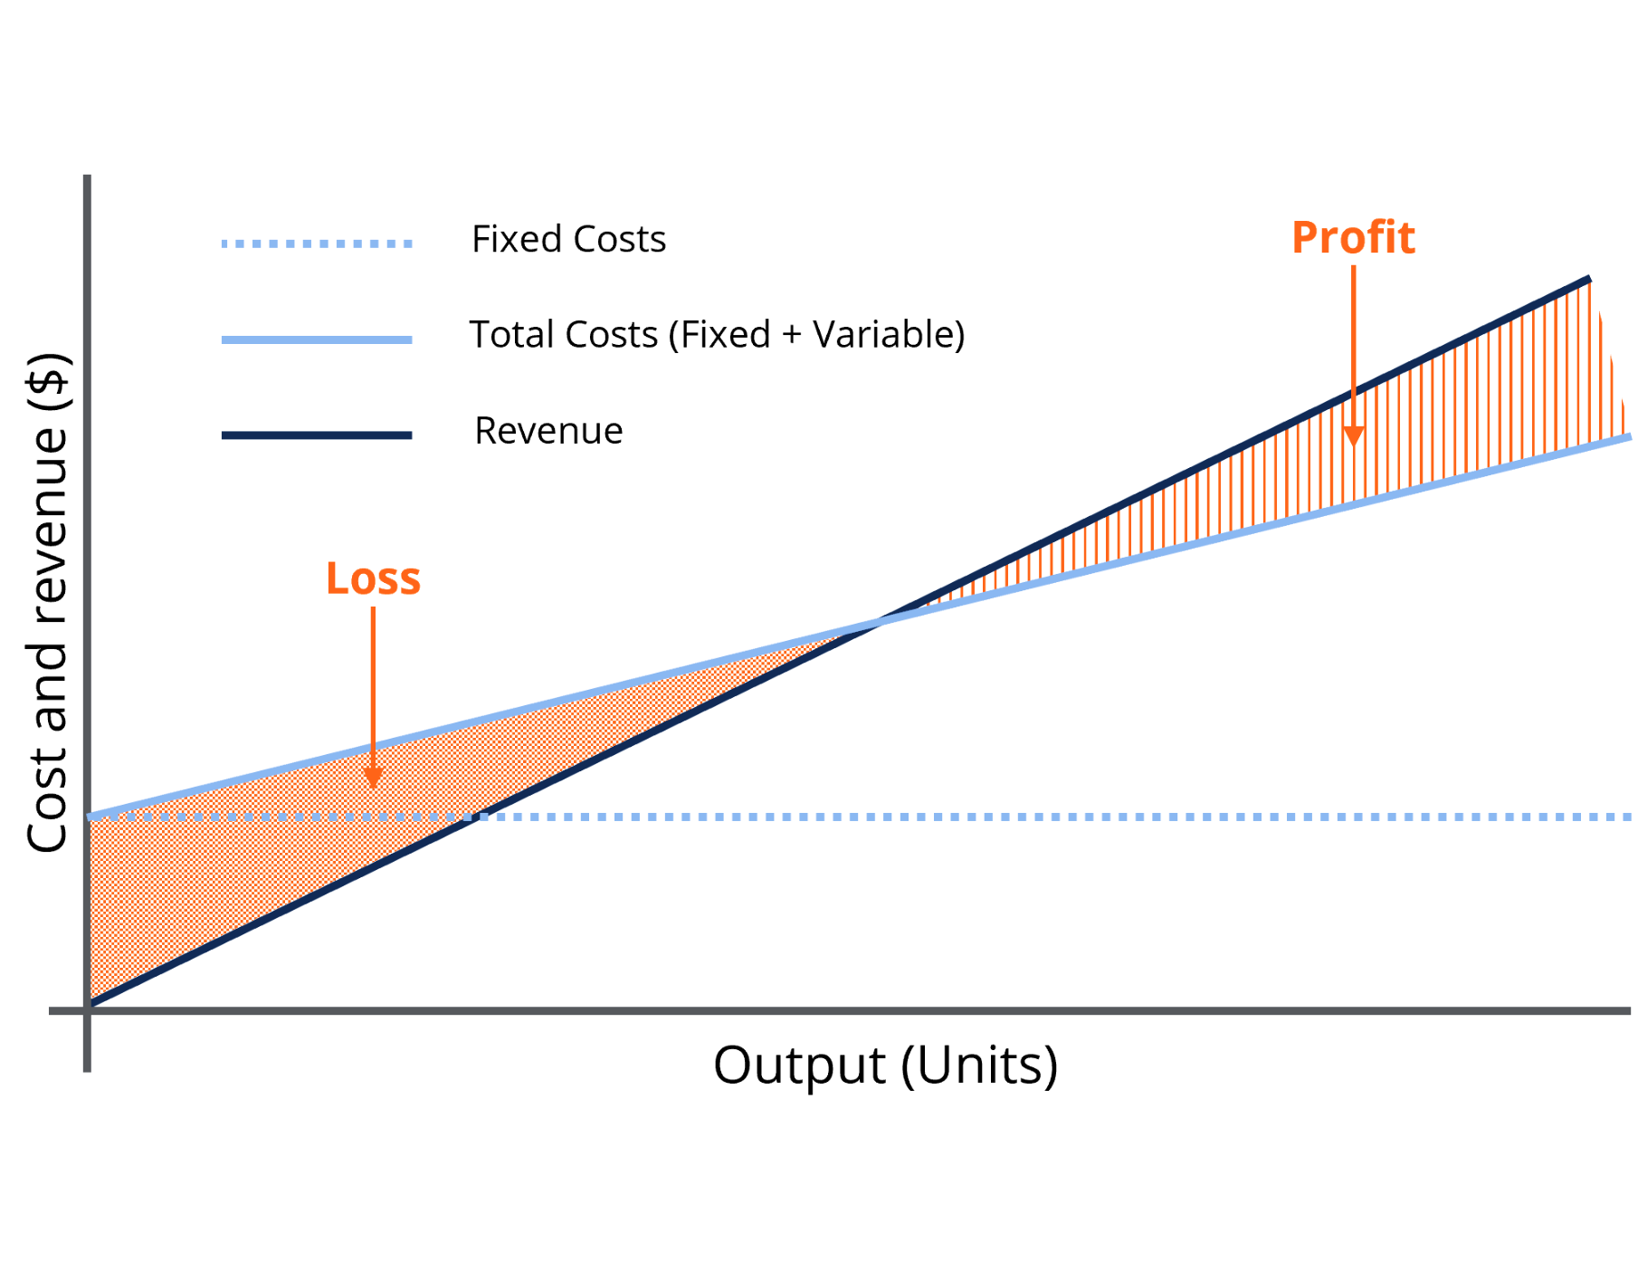
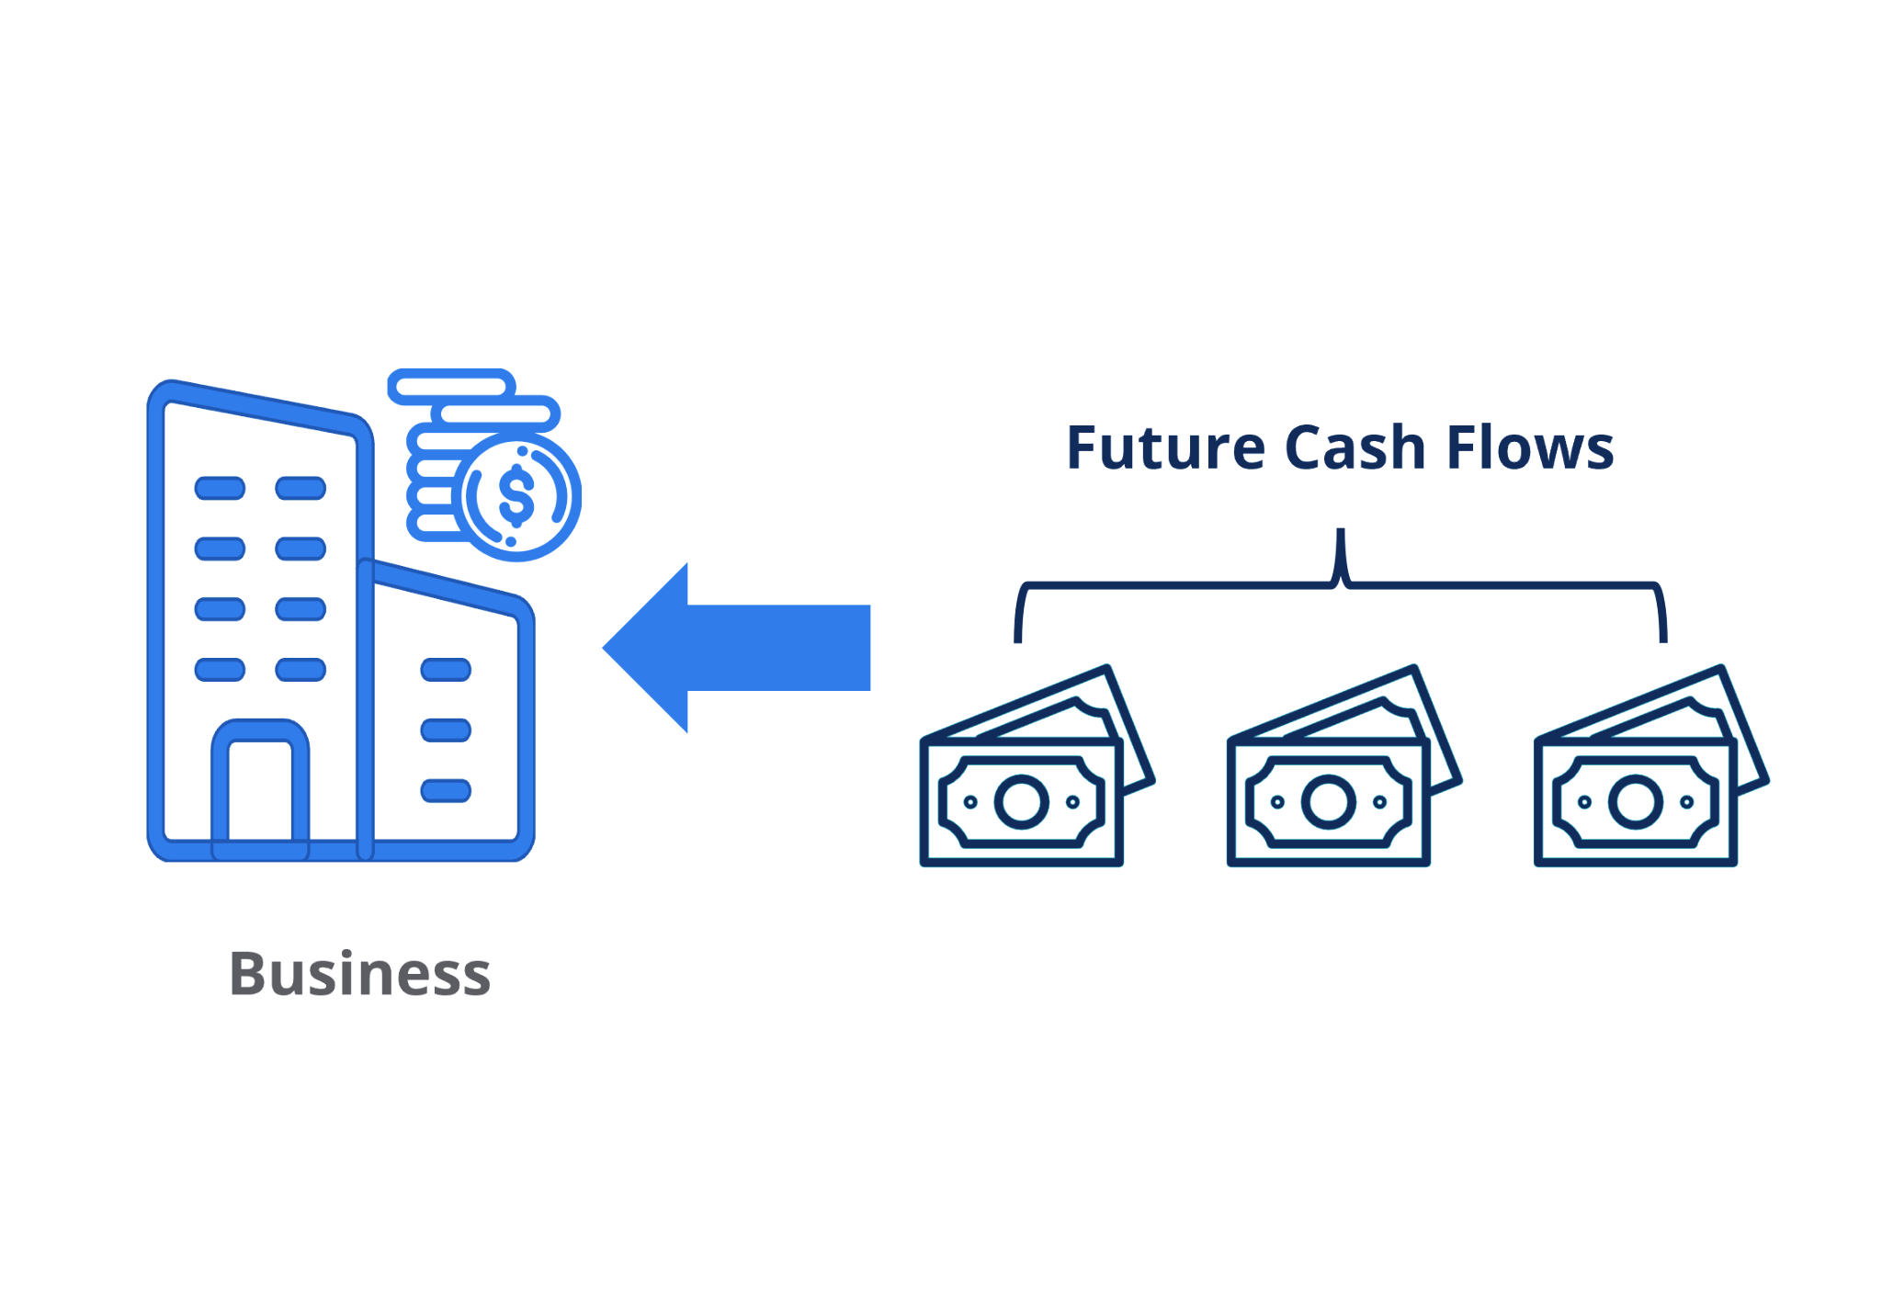
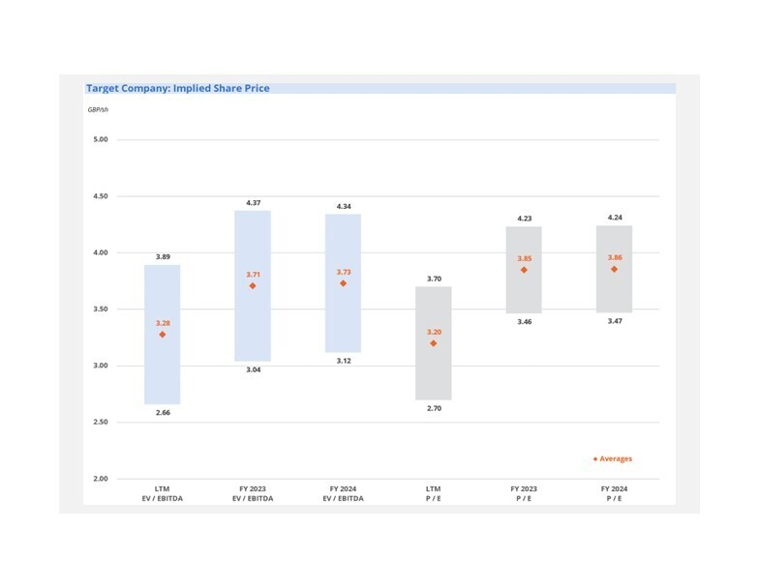
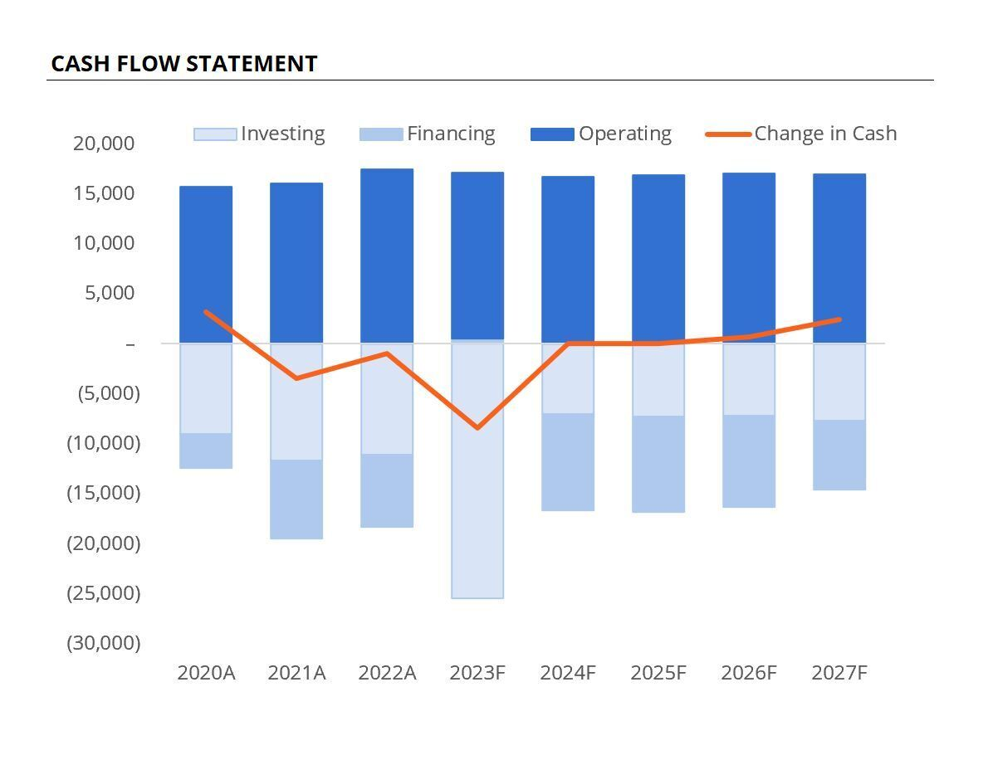
What’s Coming Soon to FMVA
ELECTIVE → CORE
BRAND NEW COURSE
Operational Modeling
DCF Valuation Modeling
BRAND NEW COURSE
REFRESHED
Comparable Valuation Analysis
3-Statement Modeling
Notes:
New core courses of the FMVA (available October 31st on the Skill Development Platform)
Operational Modeling (Elective → Core)
DCF Valuation Modeling (Brand new course)
Comparable Valuation Analysis (Brand new course)
3-Statement Modeling (Refreshed)

Slide 18
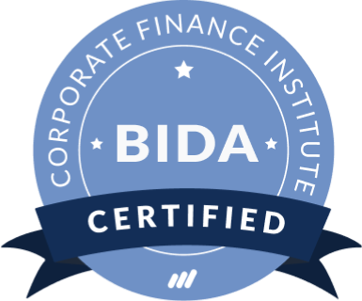
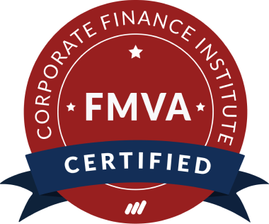
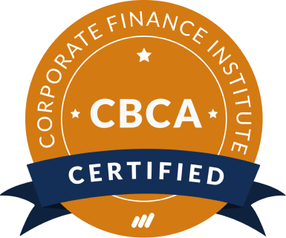

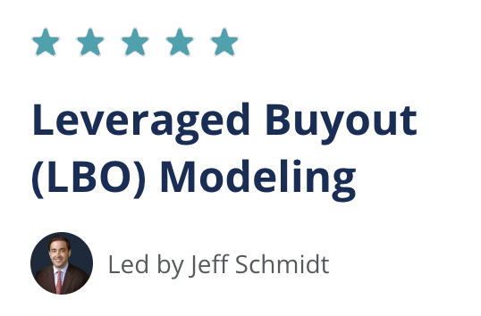



Additional Learning Content

Slide 19
Q&A

Slide 20


Financial Modeling Guidelines Virtual Event
Coming Soon
Coming late November
/corporate-finance-institute-cfi
@corporatefinanceinstitute
@cfi_edu
/Corporatefinanceinstitute-CFI

