Slide 1
Future Proof Your Career with ESG
Changing competitive landscape; changing best practices

Slide 2
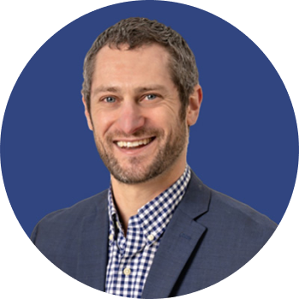
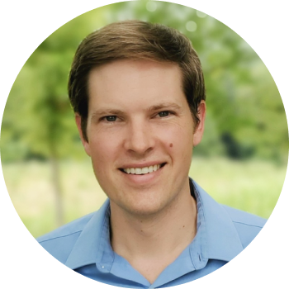
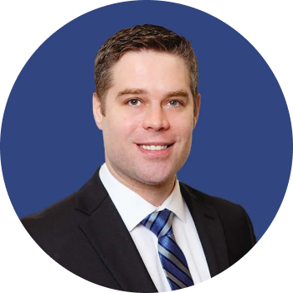
Introduction
Noah Miller, Founder & Chief Strategist, Rho Impact
Noah is the Chief Strategist and Head of ESG Advisory Services at Rho Impact. With over a decade of ESG consulting experience, Noah has held multiple leadership roles including Senior Director for Summit Strategy Group's ESG Consulting Services practice and serving as interim ESG Director for multiple public and private companies.
Seth Sheldon, Founder & Chief Scientific Officer, Rho Impact
Seth is the Chief Scientific Officer at Rho Impact and the former Director of Impact Analytics at Rho Impact's predecessor, Rho AI. Seth was influential in the methodology and scientific development of the CRANE tool - an open-source software tool for assessing the carbon reduction potential of emerging technologies and ventures.
Kyle Peterdy, VP, CBCA, CFI
Prior to joining CFI, Kyle Peterdy worked both in financial services and in education. Most recently he spent six years with RBC managing Canadian-based commercial borrowers across a variety of sectors including technology, retail & hospitality, and manufacturing & wholesale. Aside from his client-facing responsibilities, Kyle also regularly served as a mentor for new hires to support their training and development in role.

Slide 3
Agenda
Introduction
Background and history of ESG
ESG today
The future of ESG
How can CFI support learners?
Q&A

Slide 4
What is ESG?
ESG is a management and analysis framework. It provides a lens for assessing and understanding how changing environmental, social, and economic conditions impact a business and the key stakeholders the business depends on. ESG focuses on risk and opportunity management.
ENVIRONMENT
ESG
GOVER-
NANCE
SOCIAL

Slide 5
POLL
ESG is a relatively new concept in the business and finance community.
TRUE
FALSE

Slide 6
POLL
ESG is a relatively new concept in the business and finance community.
TRUE
FALSE
False – in fact, elements of ESG have been discussed since the 1950’s with Peter Drucker and his work on employee engagement and productivity.

Slide 7
Brief History
of ESG

Slide 8
Background
Where did the concept of ESG come from?
Has roots in: EHS (employee health and safety), corporate sustainability, and corporate social responsibility.
The term was coined by the UN in 2004.
The United Nations Principles of Responsible Investment (UNPRI) was also developed in 2006
NIKE example

Slide 9
POLL
What event or change in the current business environment is seen as the major catalyst that brought ESG into its current “mainstream” state?
The Covid-19 Pandemic
Increased awareness around climate impacts and their associated risks
The global reckoning on systemic racism and the Black Lives Matter movement
All of the above
The evolution of stakeholder expectations and changing regulatory environment

Slide 10
Answer
What event or change in the current business environment is seen as the major catalyst that brought ESG into its current “mainstream” state?
The Covid-19 Pandemic
Increased awareness around climate impacts and their associated risks
The global reckoning on systemic racism and the Black Lives Matter movement
ALL OF THE ABOVE
The evolution of stakeholder expectations and changing regulatory environment

Slide 11
ESG Today

Slide 12
ESG Today
What are some of the things we’re seeing in the market today with respect to core ESG issues and opportunities?
Strong ESG maturity as a signal
Climate risk IS business risk
Cost (and availability) of capital
Future-proofing business operations

Slide 13
POLL
In 5 years time, ESG (as we know it today) will not only still exist but it will be more prevalent!
TRUE
FALSE

Slide 14
Answer
In 5 years time, ESG (as we know it today) will not only still exist but it will be more prevalent!
TRUE
FALSE

Slide 15
The Future
of ESG

Slide 16
The Future of ESG
How do you recommend preparing for the future of ESG?
Stand up an internal governance structure
Set/understand SMART goals and KPIs
Measure what matters
Use software and technology to streamline and support data collection
Understand ESG disclosure looks like

Slide 17
The Future of ESG
How should members of the CFI community be thinking about future roles and their own career growth?
Every executive function will touch ESG
Every organization will need ESG capabilities, knowledge, and experience
The market for sustainable products, services, and technologies/offsets is massive (and growing)

Slide 18
How CFI Can Support Learners

Slide 19
What can learners expect from the program today and in the future?
Content has a wide (but very applicable) lens.
“Practice labs.”
Explore some unique, emerging topics that are specifically relevant to the finance and banking community.
More live events.

Slide 20
Q&A

